Slide 1
QMST 5335
Module 4.2
Kinds of Simulation and Excel Examples

Slide 2
Learning Objectives:
Understanding different simulation environments
Understanding the basics of Static Stochastic Monte Carlo Simulation
Learning how to use spreadsheet (Excel) for Static Monte Carlo
Understanding the basic working principles of Dynamic Simulation and learning about the software options
Refreshing knowledge of basic probability theory

Slide 3
Outline
Probability Theory Review
Classifying Simulations (SS Chapter 3.1)
Monte Carlo Simulation
  Static Stochastic Monte Carlo and Excel
  Monte Carlo Simulation Example
  Dynamic Simulation and Software Options
Monte Carlo Simulation Project Overview

Slide 4
Outline
Probability Theory Review
Classifying Simulations (SS Chapter 3.1)
Monte Carlo Simulation
  Static Stochastic Monte Carlo and Excel
  Monte Carlo Simulation Example
  Dynamic Simulation and Software Options
Monte Carlo Simulation Project Overview

Slide 5
Probability Theory Review
Discrete random variables:
  Suppose we have an experiment whose outcome depends on chance
    The outcome of the experiment is called random variable
    The sample space of the experiment is the set of all possible outcomes.
    A Random Variable, X, is said to be discrete if it can take on at most a countable (finite) number of values
    That is, the sample space is finite
    A subset of the sample space is called event
  Rolling a standard six-sided die
    6 possible outcomes
      Sample space, S={1,2,3,4,5,6}
    X is the outcome we get
      X is a random variable
  Rolling a standard six-sided die
    What is the probability of having an even number?
    6 possible outcomes after we roll
    Our event E={2,4,6} → P(E)=1/6+1/6+1/6=1/2
Probability of having 4 after we roll is 1/6
event

Slide 6

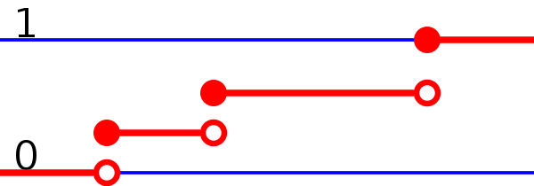
Probability Theory Review
Discrete random variables:
  P(X=x) = “Probability that X takes on the value x”
    0 ≤ P(X=x) ≤ 1
    Σ P(X=x) =1
  E[X] = “expected value of the X”
    E[X] = Σ x P(X=x)
  V[X] = “variance of the X”
    V[X] =Σ x² P(X=x) – E[X]²
    V[X]= Σ P(X=x)(x – E[X])²
  SD[X] = “standard deviation of X”
    SD[X] = √V[X]
  Rolling a die:
Probability mass function (pdf) = f(X)
Cumulative distribution function (cdf) = F(X)

Slide 7
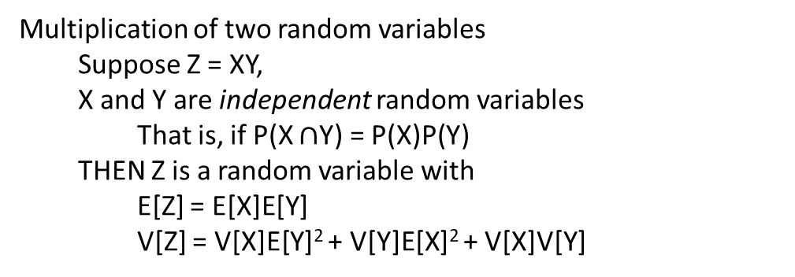
Probability Theory Review
Expectation and Variance:
  Recall that
    E[X] = Σ x P(X=x)
  We have the following properties
    E[X+c]=E[X]+c where c is a constant
    E[aX]=aE[X] where a is a constant
    E[aX+bY]=aE[X]+bE[Y] where Y is also a random variable
  Recall that
    V[X] =Σ x² P(X=x) – E[X]²
  We have the following properties
    V[X+c]=V[X] where c is a constant
    V[aX]=a²V[X] where a is a constant
    V[aX+bY]= a²V[X]+ b²V[Y] if X and Y are independent variables
Multiplication of two random variables
  Suppose Z = XY,
  X and Y are independent random variables
    That is, if P(X $∩$Y) = P(X)P(Y)
  THEN Z is a random variable with
    E[Z] = E[X]E[Y]
    V[Z] = V[X]E[Y]² + V[Y]E[X]² + V[X]V[Y]

Slide 8
Probability Theory Review
Some famous discrete probability distributions:
  Bernoulli (yes-no) distribution:
    Two outcomes: whether an event occurs or not
  Binomial Distribution:
    Describes the number of times an event occurs in a fixed number of trials (e.g., number of heads in 10 flips of a coin)
    For each trial, only two outcomes possible and Trials are independent, and Probability remains the same for each trial
  Geometric Distribution:
    Describes the number of trials until an event occurs (e.g., number of times to roll a die until a 6)
    Same probability for each trial and Continue until succeed, unlimited trials
  Negative Binomial Distribution:
    Describes the number of trials until an event occurs n times
    Similar to geometric (when n=1, you have geometric distribution)
  Poisson Distribution:
    Describes the number of times an event occurs during a given period of time or space
    Occurrences are independent and Any number of events is possible
  Discrete Uniform Distribution:
    Each outcome is equally likely (e.g., rolling a die, each outcome is 1/6 probability)
  More distributions: Wikipedia gives the basics!
https://en.wikipedia.org/wiki/List_of_probability_distributions

Slide 9
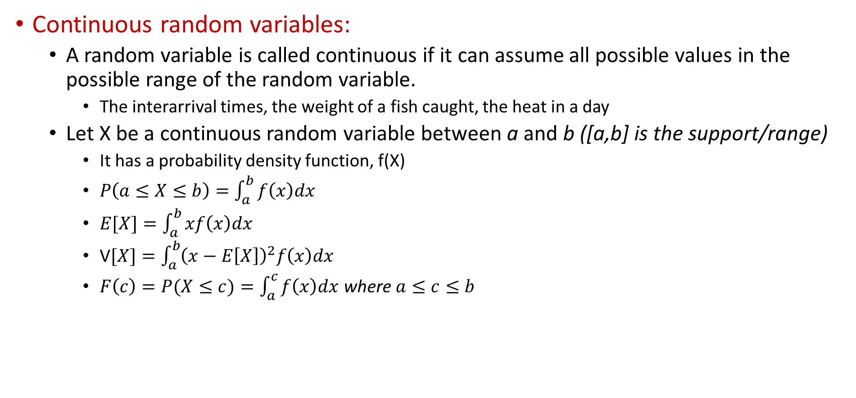
Probability Theory Review
Continuous random variables:
  A random variable is called continuous if it can assume all possible values in the possible range of the random variable.
    The interarrival times, the weight of a fish caught, the heat in a day
  Let X be a continuous random variable between a and b ([a,b] is the support/range)
    It has a probability density function, f(X)
    $P\left(a≤X≤b\right)=\int_{a}^{b}{f\left(x\right)dx}$
    $E[X]=\int_{a}^{b}{xf\left(x\right)dx}$
    V$[X]=\int_{a}^{b}{{\left(x−E\left[X\right]\right)}^{2}f\left(x\right)dx}$
    $F\left(c\right)=P(X≤c)=\int_{a}^{c}{f\left(x\right)dx}$ where $a≤c≤b$
f(X) is the probability density function
F(X) is the cumulative probability function

Slide 10
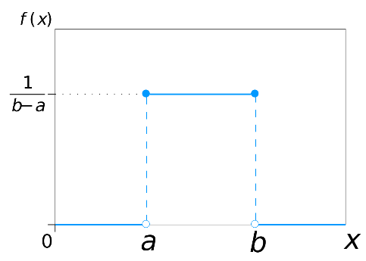
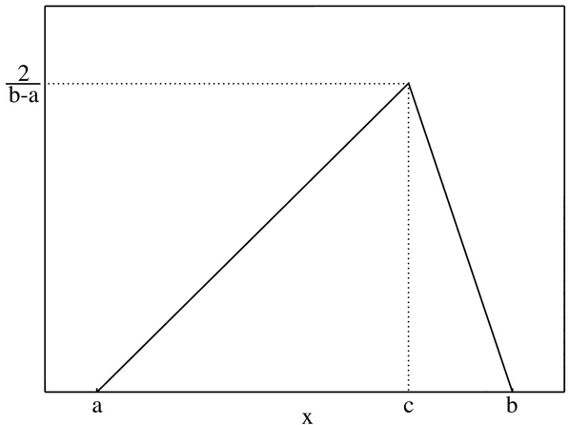
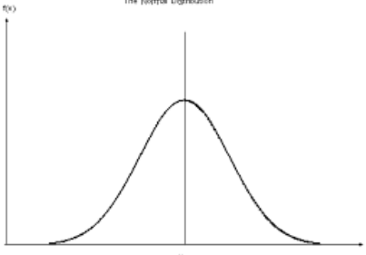
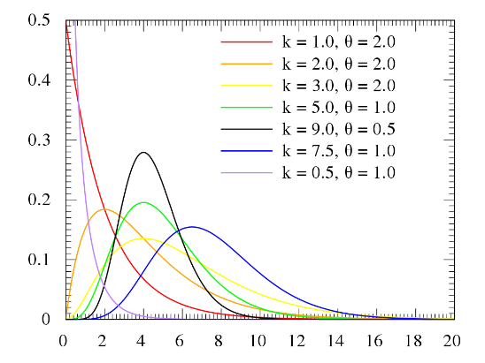
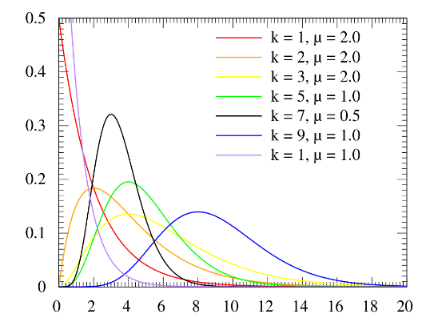
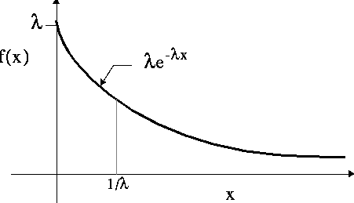
Probability Theory Review
Some famous continuous probability distributions:
  Uniform Distribution Triangular Distribution Normal Distribution
  Exponential Distribution Gamma Distribution Erlang Distribution
  More distributions: Wikipedia gives the basics!
https://en.wikipedia.org/wiki/List_of_probability_distributions

Slide 11
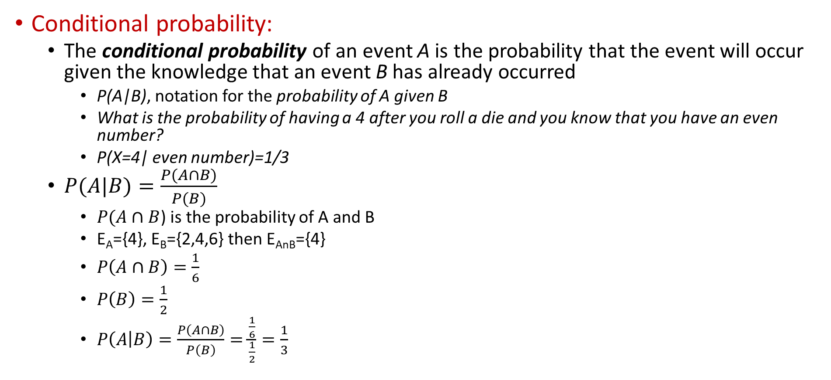
Probability Theory Review
Conditional probability:
  The conditional probability of an event A is the probability that the event will occur given the knowledge that an event B has already occurred
    P(A|B), notation for the probability of A given B
    What is the probability of having a 4 after you roll a die and you know that you have an even number?
    P(X=4| even number)=1/3
  $P(A|B)=\frac{P(A∩B)}{P(B)}$
    $P(A∩B$) is the probability of A and B
    E_{A}={4}, E_{B}={2,4,6} then E_{AnB}={4}
    $P\left(A∩B\right)=\frac{1}{6}$
    $P\left(B\right)=\frac{1}{2}$
    $P\left(A | B\right)=\frac{P\left(A∩B\right)}{P\left(B\right)}=\frac{\frac{1}{6}}{\frac{1}{2}}=\frac{1}{3}$

Slide 12
Outline
Probability Theory Review
Classifying Simulations (SS Chapter 3.1)
Monte Carlo Simulation
  Static Stochastic Monte Carlo and Excel
  Monte Carlo Simulation Example
  Dynamic Simulation and Software Options
Monte Carlo Simulation Project Overview

Slide 13
Classifying Simulations
It is a powerful modeling approach (physical vs. analytical vs. simulation)
  Enables analyzing systems in a practical manner
“Simulation” is a very broad term – too broad, so need to qualify, and classify different kinds of simulation
  Static vs. dynamic
  Continuous-change vs. discrete-change for dynamic models
  Deterministic vs. stochastic

Slide 14
Classifying Simulations
Static vs. Dynamic
  Static: Passage of time plays no active or meaningful role in model execution; can often be done in spreadsheets
    Random numbers to simulate gambling games or lottery, or to estimate the value of an integral or inverse of a matrix
    Evaluate financial profit & loss statement subject to uncertainties in demand, interest rates, etc. … get distribution/histogram of possible profits & losses to display risk, rather than just a single “projection”
  Dynamic: Passage of time is essential and explicit in model execution; can almost never be done in spreadsheets except for very simple models
    Queueing systems, dynamic inventory systems, supply chains
    Key variable: simulation clock = current value of (simulated) time
      Should be real-valued, not integer-valued since simulated time is continuous
      Should jump between (exact) event times in continuous time, not be time-stepped or time-sliced … wasted computer effort, model distortion since event times are rounded to nearest time-step boundary

Slide 15
Classifying Simulations
Continuous-change vs. discrete-change (for dynamic models)
  Dynamic models are described by state variables that describe the state as it changes over time (queue length, inventory level)
  Continuous-change: State variables can change continuously over time, at any point in continuous time
    Fluid in a tank, pressure, strength level of a combat force
    Often described by differential equations, solved numerically
    Lanchester combat equations: x(t), y(t) strengths of opposing forces at time t, dx/dt = –a y(t), dy/dt = – b x(t), a and b positive constants
  Discrete-change: State variables can change only at instantaneous, separated, discrete points in time
    Most queueing models, many inventory models
    Simulation clock takes on only values corresponding to the time of occurrence of these discrete events, so jumps from the time of one event to the time of the next event.. nothing in between
    At time of each event, simulation logic alters state variables, other things (event calendar, statistical-tracking variables …)
      Customers arrive at discrete time points
      The number of customers in the system changes when a customer arrives

Slide 16
Classifying Simulations
Deterministic vs. stochastic
  Deterministic: All input values are fixed, non-random constants
    Manufacturing system with constant interarrival, service times
    Get same results from multiple runs, unless your change input(s)
  Stochastic: Some inputs are random draws (or samples or realizations) from probability distributions
    Manufacturing system with interarrival, service times that vary according to probability distributions … must specify these input distributions from observed data
    The random draws start with a random-number generator, so running model once provides only a sample (of size 1, not worth much) of what could happen
    So, need to run it many times (or for a long time) to judge statistical behavior of output (precision of estimates, spread/risk or results)
    Usually, subsequent executions of same model yield same results … instead, must replicate within same execution to keep going in fixed “random”-number sequence … it’s actually good that it’s fixed (debugging, variance reduction)

Slide 17
Outline
Probability Theory Review
Classifying Simulations (SS Chapter 3.1)
Monte Carlo Simulation
  Static Stochastic Monte Carlo and Excel
  Monte Carlo Simulation Example
  Dynamic Simulation and Software Options
Monte Carlo Simulation Project Overview

Slide 18
Monte Carlo Simulation and Excel
Monte Carlo Simulation:
  Name comes from the Mediterranean gambling center.
  Simplest form of stochastic simulation.
  Sometimes used in spreadsheets and applications where the dynamic nature of most systems is not an issue
  It can also be used for some dynamic systems (when the process relations are relatively easier to model)
Some examples with Excel
  Throwing two dice
    Module 2 - Two Dice.xlsx uses RAND and VLOOKUP functions to estimate the outcome of dice rolls
  Newsvendor: Single Period Inventory Profits
    Module 2 - Newsvendor.xlsx uses RAND to generate data from Uniform distribution.
  Monte Carlo integration
    Module 2 - Integration.xlsx uses RAND and NORMDIST functions to estimate the area under a curve.

Slide 19
Monte Carlo Simulation and Excel
Throwing two dice
  Throw 2 fair (six-sided) dice and take the result as the sum of the faces that come up
  We want to see how the result is distributed and find average result
    Average = Mean of the results over the repeated experiments
    Mean is different than expected value: Mean → Expected Value if we repeat the experiment infinitely many times
Die 1’s result ($X_{1}$)
Die 1’s result (𝑋_1)
Die 2’s result ($X_{2}$)
Die 2’s result (𝑋_2)
Result of Interest ($Y$)
Result of Interest (𝑌)
A random variable
A random variable
A random variable
We know about their distributions
We want to simulate

Slide 20

Monte Carlo Simulation and Excel
Throwing two dice
  What we know? These will be input to the simulation model
  We know the probability distribution of the result of each single die
    $X_{1}∈\{1,2,3,4,5,6\}$ and $X_{2}∈\{1,2,3,4,5,6\}$
i | P(Face = i) | P(Face < i)
1 | 0.1667 | 0.0000
2 | 0.1667 | 0.1667
3 | 0.1667 | 0.3333
4 | 0.1667 | 0.5000
5 | 0.1667 | 0.6667
6 | 0.1667 | 0.8333
Note that both X1 and X2 (i.e., the face) have discrete uniform distributions
Outcome space (set of possible values)
Probability mass
function
Cumulative distribution function

Slide 21
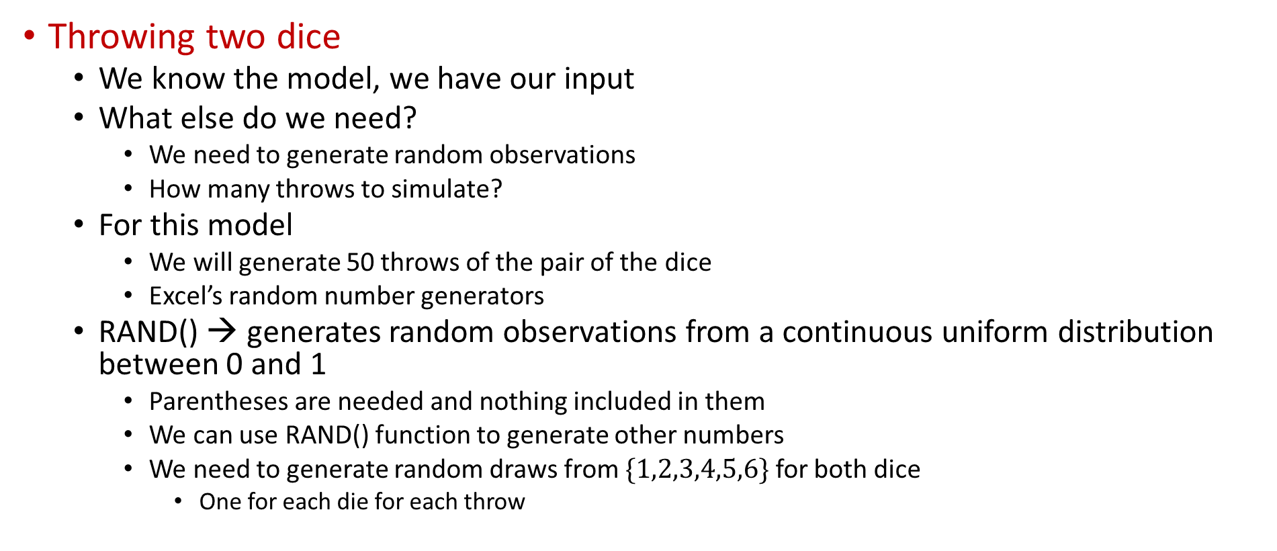
Monte Carlo Simulation and Excel
Throwing two dice
  We know the model, we have our input
  What else do we need?
    We need to generate random observations
    How many throws to simulate?
  For this model
    We will generate 50 throws of the pair of the dice
    Excel’s random number generators
  RAND() → generates random observations from a continuous uniform distribution between 0 and 1
    Parentheses are needed and nothing included in them
    We can use RAND() function to generate other numbers
    We need to generate random draws from $\{1,2,3,4,5,6\}$ for both dice
      One for each die for each throw

Slide 22
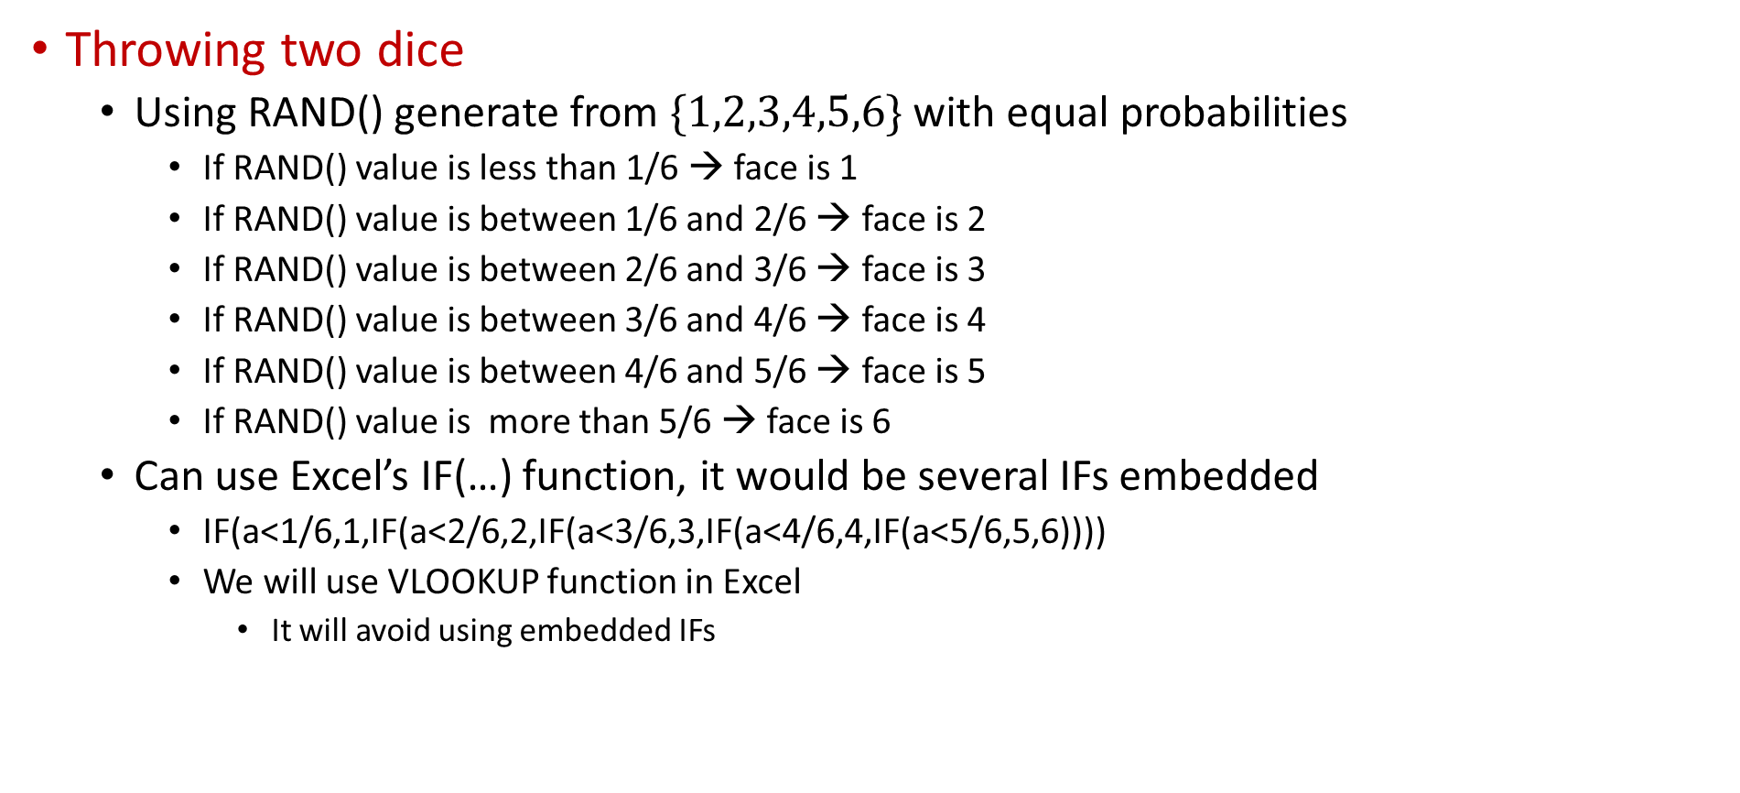
Monte Carlo Simulation and Excel
Throwing two dice
  Using RAND() generate from $\{1,2,3,4,5,6\}$ with equal probabilities
    If RAND() value is less than 1/6 → face is 1
    If RAND() value is between 1/6 and 2/6 → face is 2
    If RAND() value is between 2/6 and 3/6 → face is 3
    If RAND() value is between 3/6 and 4/6 → face is 4
    If RAND() value is between 4/6 and 5/6 → face is 5
    If RAND() value is more than 5/6 → face is 6
  Can use Excel’s IF(…) function, it would be several IFs embedded
    IF(a<1/6,1,IF(a<2/6,2,IF(a<3/6,3,IF(a<4/6,4,IF(a<5/6,5,6))))
    We will use VLOOKUP function in Excel
      It will avoid using embedded IFs

Slide 23

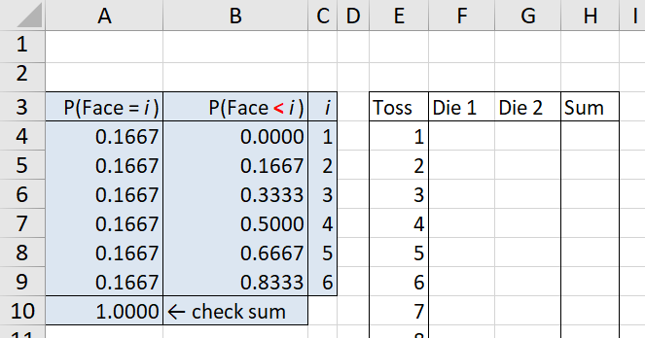
Monte Carlo Simulation and Excel
Throwing two dice
  We will use VLOOKUP function in Excel
VLOOKUP, with its fourth argument set to TRUE, returns the value in the second column (that’s what the 2 is for in the third argument) of the cell range B4:C9 (the second argument) in the row corresponding to the values between which RAND() (the first argument) falls in the first column of B4:C9.
Input (B and C cells)
Toss # (we’ll have 50)
Sum : We are looking for this (column H)
Random values for die 1 (column F)
Random values for die 2 (column G)

Slide 24
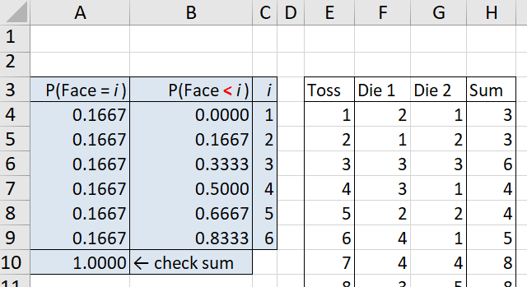

Monte Carlo Simulation and Excel
Throwing two dice
  We will use VLOOKUP function in Excel
VLOOKUP: how it works?
We’ll get C4 (which is 1) if RAND() is between B4 and B5, i.e., between 0 and 1.667, which is our first subinterval of width of length 1/6 as desired
If RAND() is not in the first subinterval, VLOOKUP moves on to the second interval, between B5 and B6, so between 0.1667 and 0.3333, and returns C5 (which is 2) if RAND() is between these two values, which will occur with probability 1/6
This continues up to last subinterval as needed
https://support.office.com/en-us/article/vlookup-function-0bbc8083-26fe-4963-8ab8-93a18ad188a1
→ Every time, excel will generate fresh random numbers!

Slide 25
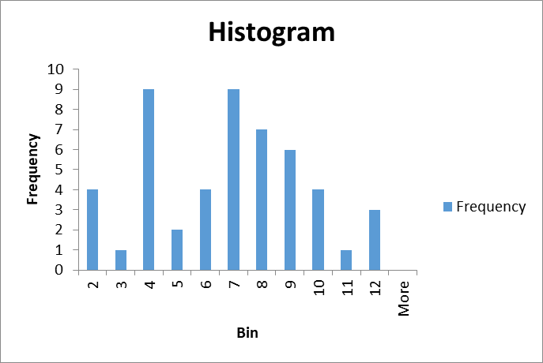
Monte Carlo Simulation and Excel
Throwing two dice
  Looking at the results!
  See ‘Module 2 - Two Dice.xlsx’ file
Use: Data Analysis → Histogram tool of Excel
https://www.youtube.com/watch?v=Giewd9yH4q0
There are more youtube videos!

Slide 26
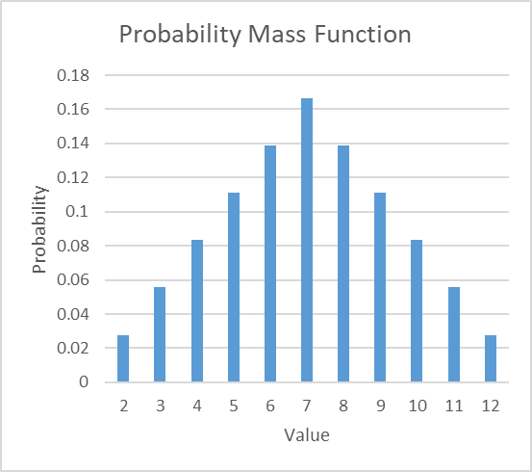
Monte Carlo Simulation and Excel
Throwing two dice
  Analytical model!
    See ‘Module 2 - Two Dice.xlsx’ file
So, maybe we needed more than 50 tosses!

Slide 27
Monte Carlo Simulation and Excel
More Excel Tools:
Several Excel functions can be used to generate random numbers from a normal distribution
  Check, NORMDIST function of excel
    https://support.office.com/en-us/article/normdist-function-126db625-c53e-4591-9a22-c9ff422d6d58
  Also check, NORMINV function of excel
    https://support.office.com/en-us/article/norminv-function-87981ab8-2de0-4cb0-b1aa-e21d4cb879b8
  Use the formula "=NORMINV(RAND(),B2,C2)", where the RAND() function creates your probability, B2 provides your mean and C2 references your standard deviation.
    https://smallbusiness.chron.com/generate-random-variable-normal-distribution-excel-74203.html

Slide 28
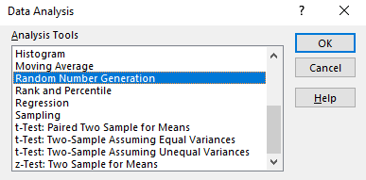
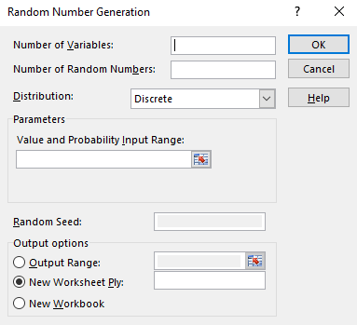
Monte Carlo Simulation and Excel
More Excel Tools:
Data Analysis → Random Number Generation
The number of variables for which we want to generate random draws. Note that the variables should have identical probability distributions
How many random numbers (draws) we want to generate for each variable. Again, for each identically distributed r.v., we will generate the same number of draws
For instance, if discrete distribution is selected, the probability mass function should be put here
From the drop-down menu, select the distribution of the random variable. Depending on the selected distribution, different input parameters will be asked
Is about the generation process, can leave empty
Where we want to have the random draws

Slide 29
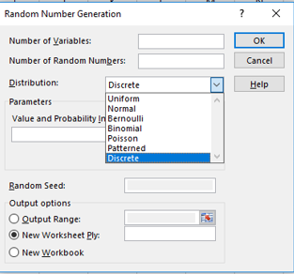
Monte Carlo Simulation and Excel
More Excel Tools:
Data Analysis → Random Number Generation
  Can be used to generate from
    Uniform (continuous between a and b)
    Normal Distribution (with mean and std. dev.)
    Bernoulli (with probability of failure)
    Binomial (with probability of failure and # of trials)
    Poisson (with rate lambda)
    Patterned (an empirical distribution with specifics)
    Discrete (with probability mass function)

Slide 30
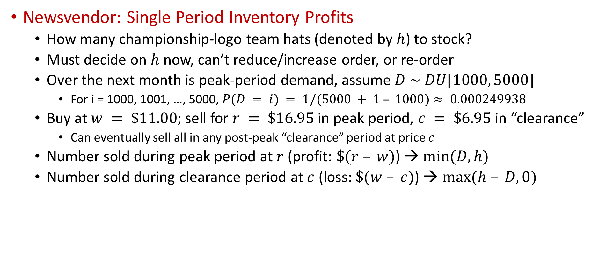
Monte Carlo Simulation Example
Newsvendor: Single Period Inventory Profits
  How many championship-logo team hats (denoted by $h$) to stock?
  Must decide on $h$ now, can’t reduce/increase order, or re-order
  Over the next month is peak-period demand, assume $D \sim DU[1000, 5000]$
    For i = 1000, 1001, …, 5000, $P(D = i) = 1/(5000 + 1 – 1000)≈ 0.000249938$
  Buy at $w = \$11.00$; sell for $r = \$16.95$in peak period, $c = \$6.95$in “clearance”
    Can eventually sell all in any post-peak “clearance” period at price $c$
  Number sold during peak period at $r$ (profit: $\$(r – w)$) → $min⁡(D, h)$
  Number sold during clearance period at $c$ (loss: $\$(w – c)$) → $max⁡(h – D, 0)$
  Total profit: $Z(h) = r min⁡(D, h) + c max⁡(h – D, 0) – wh$
Peak revenue
Clearance revenue
Total revenue
Total cost

Slide 31

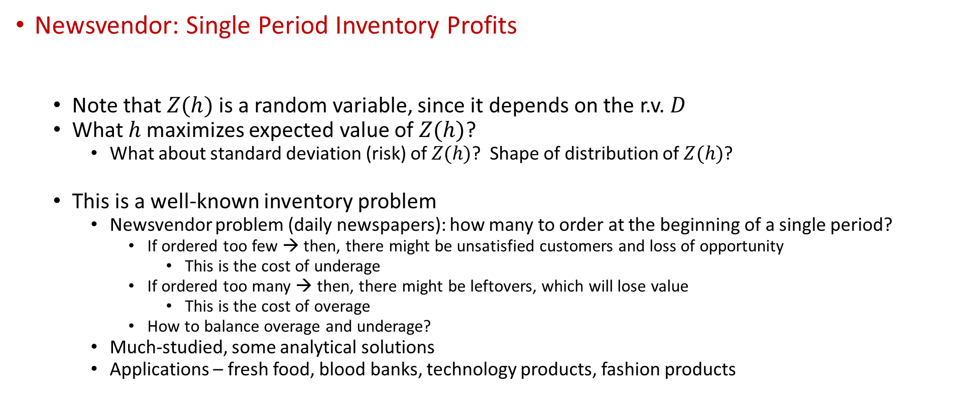
Monte Carlo Simulation Example
Newsvendor: Single Period Inventory Profits
  Note that $Z(h)$ is a random variable, since it depends on the r.v. $D$
  What $h$ maximizes expected value of $Z(h)$?
    What about standard deviation (risk) of $Z(h)$? Shape of distribution of $Z(h)$?
  This is a well-known inventory problem
    Newsvendor problem (daily newspapers): how many to order at the beginning of a single period?
      If ordered too few → then, there might be unsatisfied customers and loss of opportunity
        This is the cost of underage
      If ordered too many → then, there might be leftovers, which will lose value
        This is the cost of overage
      How to balance overage and underage?
    Much-studied, some analytical solutions
    Applications – fresh food, blood banks, technology products, fashion products
Total profit: $Z(h) = r min⁡(D, h) + c max⁡(h – D, 0) – wh$

Slide 32
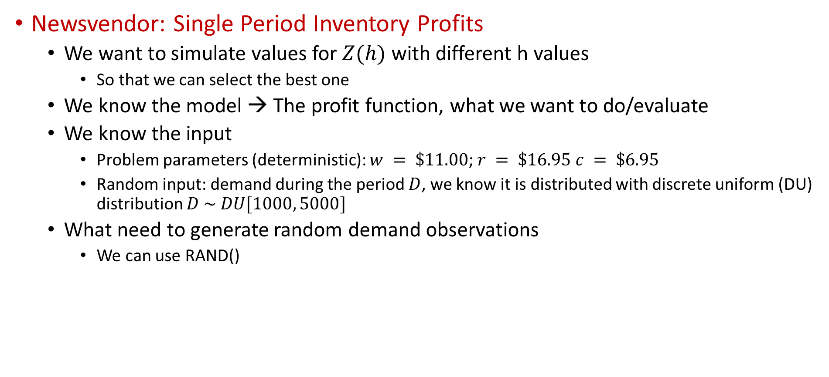
Monte Carlo Simulation Example
Newsvendor: Single Period Inventory Profits
  We want to simulate values for $Z(h)$ with different h values
    So that we can select the best one
  We know the model → The profit function, what we want to do/evaluate
  We know the input
    Problem parameters (deterministic): $w = \$11.00$; $r = \$16.95 c = \$6.95$
    Random input: demand during the period $D$, we know it is distributed with discrete uniform (DU) distribution $D \sim DU[1000, 5000]$
  What need to generate random demand observations
    We can use RAND()
$$D=\left\lfloor 1000+\left(5000−1000+1\right)∗RAND()\right\rfloor$$

Slide 33
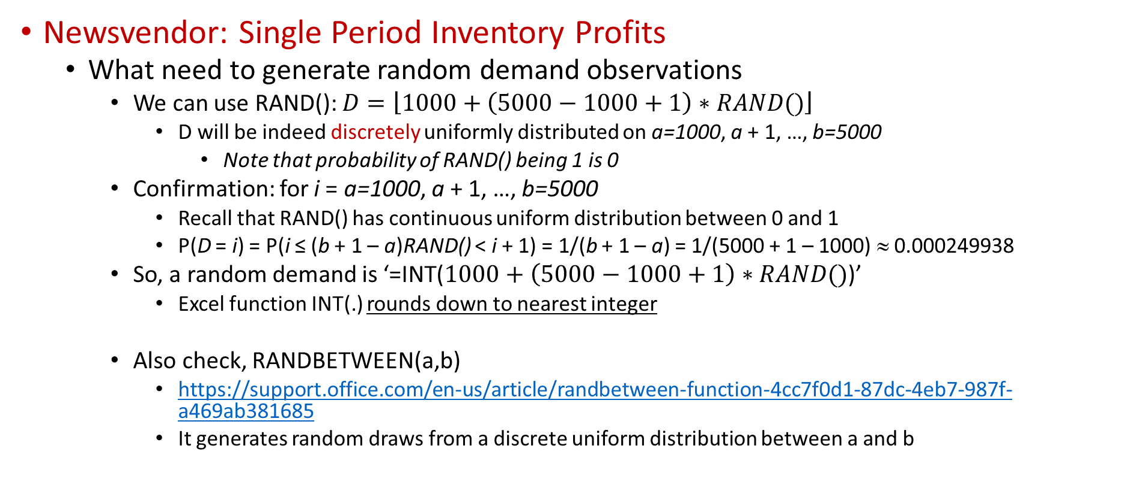
Monte Carlo Simulation Example
Newsvendor: Single Period Inventory Profits
  What need to generate random demand observations
    We can use RAND(): $D=\left\lfloor 1000+\left(5000−1000+1\right)∗RAND()\right\rfloor$
      D will be indeed discretely uniformly distributed on a=1000, a + 1, …, b=5000
        Note that probability of RAND() being 1 is 0
    Confirmation: for i = a=1000, a + 1, …, b=5000
      Recall that RAND() has continuous uniform distribution between 0 and 1
      P(D = i) = P(i ≤ (b + 1 – a)RAND() < i + 1) = 1/(b + 1 – a) = 1/(5000 + 1 – 1000) ≈ 0.000249938
    So, a random demand is ‘=INT($1000+\left(5000−1000+1\right)∗RAND()$)’
      Excel function INT(.) rounds down to nearest integer
    Also check, RANDBETWEEN(a,b)
      https://support.office.com/en-us/article/randbetween-function-4cc7f0d1-87dc-4eb7-987f-a469ab381685
      It generates random draws from a discrete uniform distribution between a and b

Slide 34

Monte Carlo Simulation Example
Newsvendor: Single Period Inventory Profits
  Simulation strategy:
    Generate 50 $D$ values (50 is chosen arbitrarily)
    Using the same D values, calculate the profits of different h values under these D values
      Could use independent demands D across different values of h, but using the same D’s is better since differences across h will be more likely due to h, and not just getting different D’s (since you’re not)
    Suppose that we can order in batches of 1000
      So we will either order 1 batch (i.e., 1000 hats), 2 batches (i.e., 2000 batches), 3 batches (i.e., 3000 batches), 4 batches (i.e., 4000 batches), or 5 batches (i.e., 5000 batches)
        Would not order more than 5 batches as the max demand is 5000 units
        Would not order less than 1 batch as the min demand is 1000 units
    So, for each h, we will calculate the profit 50 times (one for each D realization)

Slide 35
Monte Carlo Simulation Example
Newsvendor: Single Period Inventory Profits
See ‘Module 2 - Newsvendor.xlsx’ file
→ Familiarize yourself with the Excel tools/functions used for graphics and other calculations

Slide 36
Monte Carlo Simulation Example
Newsvendor: Single Period Inventory Profits
For each h, we can get statistics on the 50 observed (simulated) Z(h)’s – average, standard deviation, 95% confidence interval on E(Z(h)), min, max, and proportion < 0 (estimates probability of losing money)
Also make histogram of the 50 independently identically distributed (IID) values of the Z(h)’s for each h, I-beam confidence-interval plot vs. h to estimate expected-profit-maximizing h
  Will not get into the Excel graphics details for these graphs
Choosing h = 1000 is riskless
  You know that peak-period demand will be at least 1000
  So you know you sell out every time, get profit $5950 every time, no variation, no risk
At the other extreme, choosing h = 5000 is very risky
  Will always be stuck with inventory to dump at clearance (downside)
  But will never lose any peak-period sales (upside)
Rows 5-6 show best possible, worst possible profit for each h
  Intermediate values of h appear better than either extreme
  Higher h implies higher risk (histogram spreads, probability of loss, width of confidence interval on expected profit), both downside and upside
  Choosing h around 3000 or 4000 appears to maximize expected profit … tap F9 and watch I-beam plot on the left as a function of h

Slide 37
Dynamic Simulation and Software Options
Dynamic Simulation: Passage of time is essential and explicit in model execution; can almost never be done in spreadsheets except for very simple models
  Queueing systems, dynamic inventory systems, supply chains
  Key variable: simulation clock = current value of (simulated) time
    Should be real-valued, not necessarily integer-valued, since simulated time is continuous
  Should jump between (exact) event times in continuous time, not be time-stepped or time-sliced … wasted computer effort, model distortion since event times are rounded to nearest time-step boundary …
  All dynamic simulations operate via the same logic underneath, though high-level simulation software spares you from this
    But it’s important to see how it works, e.g. for debugging
    Also, it’s the logic used if coding a dynamic simulation in C++, Java, etc.

Slide 38
Dynamic Simulation and Software Options
An Illustration with Spreadsheet:
  Manual Dynamic Simulation
    A single-server queue, a registration desk in urgent-care clinic
    Input randomness
      Time between arrivals of consecutive customers: inter-arrival times
      Service times: how long a customer takes to be served
    What do we want? Analyze:
      How much a customer waits in line on average?
      How much a customer stays in the system?
      How many customers wait in line on average?
Registration
Arriving
patients
Reg. Desk
Departing
patients
Patient being
registered
Queue

Slide 39
Dynamic Simulation and Software Options
An Illustration with Spreadsheet:
  Manual Dynamic Simulation
    Assuming first-come first-served, customers get in the queue if the server is busy, and the server next helps the customer in front of the queue, and server is idle if there is no-one in the sytem
  Strategy:
    We can generate random numbers for the interarrival times and service times
    Then use those to identify events that occur at instants of simulated time, may change the system state variables
      Arrival of a patient entity
      Departure of a patient entity, after completing registration service
    We can also calculate
      How many customers in the system at any point selected during the simulation time
      How much each customer spends in the queue (time spent from the moment s/he enters the system until the moment s/he starts getting help from the server)
      What percentage of time the server is busy vs. idle (server utilization)
      And so on…

Slide 40
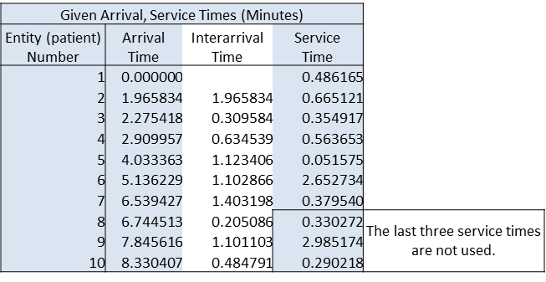
Dynamic Simulation and Software Options
An Illustration with Spreadsheet:
  Manual Dynamic Simulation
See ‘Module 2 - Manual Dynamic Smiulation.xlsx’ file

Slide 41
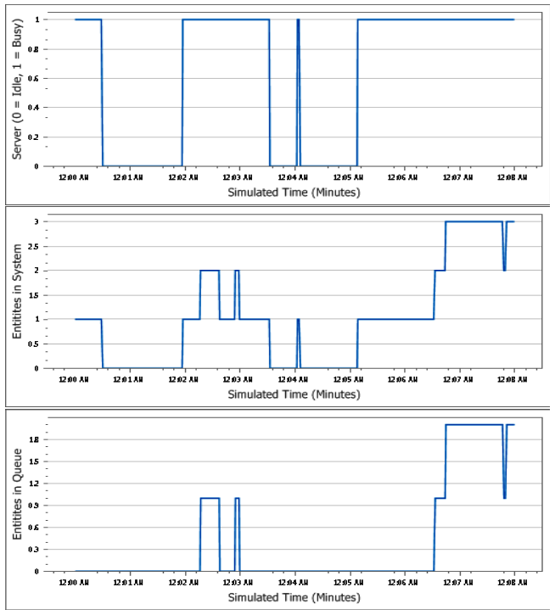
Dynamic Simulation and Software Options
An Illustration with Spreadsheet:
  Manual Dynamic Simulation

Slide 42
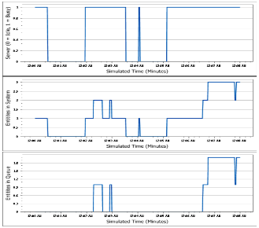
Dynamic Simulation and Software Options
An Illustration with Spreadsheet:
  Manual Dynamic Simulation
    Utilization of server (proportion or percent of time busy)
    Average, minimum, maximum of:
      Total entity (patient) time in system (entry-exit)
      Entity time in queue
      Number of entities in system (WIP)
      Number of entities in queue (queue length)
    Averages of discrete-time processes are just simple averages
    (Continuous) time averages:
      Let: L(t) = number in system (WIP) at time t
      L_{q}(t) = number in queue at time t
    B(t) = 1 if server is busy at time t, 0 if idle at time t
      Time-averages (T = simulation run length = 8 minutes):
      Time-average number in system (WIP) = ∫₀ L(t)dt/T
      Time-average number in queue = ∫₀ L_{q}(t) dt/T
      Server utilization (proportion) = ∫₀ B(t) dt/T
Discrete-time processes
a.k.a. observational, tally
Continuous-time processes
a.k.a. time-persistent, discrete-change
Need to calculate the areas under the rectangles

Slide 43
Dynamic Simulation and Software Options
Static simulations can often be done effectively in spreadsheets
  With, without special simulation add-ins (@RISK, Crystal Ball, Risk Solver)
  Make many replications of a given spreadsheet’s logic, record results as histograms, summary measures … much better than just “running” the spreadsheet once to get a single-number “projection”
  Can measure risk, often very important, missed in “projections”
Dynamic simulations are nearly impossible to do in spreadsheets
  Except for the most extremely simple (trivial?) cases, due to complex logic that doesn’t fit well in two-dimensional thinking/modeling
But we are not hopeless!
  There are software options for simulation!

Slide 44
Dynamic Simulation and Software Options
Software Options
  General-purpose programming languages: Could code up logic in manual simulation in C++, Java, Matlab, …
    In fact, even the formatting of the slides for arrival-event logic, departure-event logic, resembles procedural code structure
    Historically has been done a lot, sometimes still is due to execution speed, better flexibility
    Painstaking to write, (analyst-)time-consuming, error-prone
    Still need to identify events, define their logic, lots more work:
      Also data structures for state variables, statistical-tracking variables, clock, event calendar
      Tie event programs together with logic to execute the next event
      Program ending conditions, summarization of results
    Random-number generator, generating random “variates” from desired input distributions
      Can sometimes link such code as modules to larger model
      Overall: Better flexibility and faster execution but Complex and long modeling

Slide 45
Dynamic Simulation and Software Options
Software Options
  Special-purpose simulation software:
    We saw several approaches to doing simulations
      Manual – OK for learning principles, obviously completely impractical for any real applications
      General-purpose programming languages –complete flexibility and speed, but too time-consuming, error-prone for models of complex systems
      Spreadsheets – work well for static “risk” simulations (especially with an appropriate add-in), but just can’t handle the logic and data-structure complexity of general dynamic simulations
  Specialized dynamic simulation software has actually been around since the 1960s
    Simio is a relatively new entry, but developed by the same people who earlier developed several other packages, so lots of experience behind it
      Simio uses an object-oriented graphical approach to simplify modeling
      There are many other software options!
        They all look similar and work similar
        Arena is another one, for instance, and very similar to Simio

Slide 46
Outline
Probability Theory Review
Classifying Simulations (SS Chapter 3.1)
Monte Carlo Simulation
  Static Stochastic Monte Carlo and Excel
  Monte Carlo Simulation Example
  Dynamic Simulation and Software Options
Monte Carlo Simulation Project Overview

Slide 47
Monte Carlo Simulation Project
Case Study: Analyzing Free Shipping Strategies
Suppose that you are the promotion manager of your company.
You company sells one item
  It is bought from the supplier for $20 per unit
  It is sold to the customers for $50 per unit
  Customers want to buy as many as possible within their budget but not more than 3
  Shipping cost is $25 regardless of how many items are purchased by the customer

Slide 48
Monte Carlo Simulation Project
Free Shipping Strategies
The company is considering four free shipping strategies:
Offering free shipping for purchases of 4 or more items, which effectively means no free shipping since customers do not buy more than 3 items.
Offering free shipping for purchases of 3 or more items.
Offering free shipping for purchases of 2 or more items.
Offering free shipping for any purchase, including just 1 item.

Slide 49
Customer’s Purchase Decisions
Customers want to buy as many items as possible (the more the better)
A customer can buy at most three items
Recall that each item is sold for 50 dollars and shipping cost is $25 (regardless of how many items purchased by the customer)
Let’s say, customer’s budget is $120
Under Strategy-1: Without any free shipping offer:
  The customer would only buy 1 item.
  The remaining budget after shipping costs, which is equal to $120-$25 = $95, would not allow for the purchase of a second item.
  The company’s net profit would be 1x$30=$30 since the company does not incur any shipping cost.

Slide 50
Customer’s Purchase Decisions
Customers want to buy as many items as possible (the more the better)
A customer can buy at most three items
Recall that each item is sold for 50 dollars and shipping cost is $25 (regardless of how many items purchased by the customer)
Let’s say, customer’s budget is $120
Under Strategy-2: If a free shipping is offered for buying 3 or more items:
  The customer would only be able to buy 1 item, since buying 3 products is out of her budget. That is, 3x$50 = $150 > $ 120.
  The customer needs to pay for $25 shipping cost, and her remaining budget, $120-$25 = $95, would allow her to buy at most 1 item.
  The company’s net profit would be 1x$30=$30 since the company does not incur any shipping cost.

Slide 51
Customer’s Purchase Decisions
Customers want to buy as many items as possible (the more the better)
A customer can buy at most three items
Recall that each item is sold for 50 dollars and shipping cost is $25 (regardless of how many items purchased by the customer)
Let’s say, customer’s budget is $120
Under Strategy-3: If a free shipping is offered for buying 2 or more items:
  The customer would opt to buy 2 items, because the cost of buying 2 items is within the budget of the customer as her order qualifies for free shipping. That is 2x$50 = $100 < $120.
  The company’s net profit would be 2x$30 - $ 25 =$35 since the company would pay for the shipping.

Slide 52
Customer’s Purchase Decisions
Customers want to buy as many items as possible (the more the better)
A customer can buy at most three items
Recall that each item is sold for 50 dollars and shipping cost is $25 (regardless of how many items purchased by the customer)
Let’s say, customer’s budget is $120
Under Strategy-4: If a free shipping is available for any purchase:
  The customer would still buy 2 items, would not pay for shipping.
  The company’s net profit would be 2x$30 - $ 25 =$35 since the company would pay for the shipping.

Slide 53
Customer’s Purchase Decisions
Let
  B= customer’s budget
  NB = # of items bought by the customer
  CSP=Company’s Sales Profit,
  CSC=Company’s Shipping Cost from one customer
Other examples:
  B=$160
    No free shipping →NB=2→ CSP = 60, CSC=0
    Free shipping for 3 items → NB=3→ CSP=90, CSC=25
    Free shipping for 2 or more items → NB=3→ CSP=90, CSC=25
    Free shipping for 2 or more items → NB=3→ CSP=90, CSC=25
  Customer’s budget is $100
    No free shipping → NB=1→ CSP = 30, CSC=0
    Free shipping for 3 items → NB=1→ CSP=30, CSC=0
    Free shipping for 2 or more items → NB=2→ CSB=60, CSC=25
    Free shipping for 1 or more items → NB=2→ CSB=60, CSC=25

Slide 54
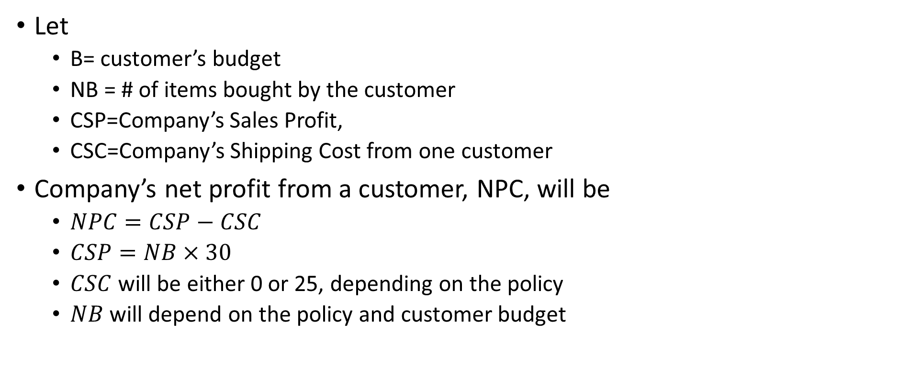
Company’s Net Profit
Let
  B= customer’s budget
  NB = # of items bought by the customer
  CSP=Company’s Sales Profit,
  CSC=Company’s Shipping Cost from one customer
Company’s net profit from a customer, NPC, will be
  $NPC=CSP−CSC$
  $CSP=NB×30$
  $CSC$ will be either 0 or 25, depending on the policy
  $NB$ will depend on the policy and customer budget

Slide 55
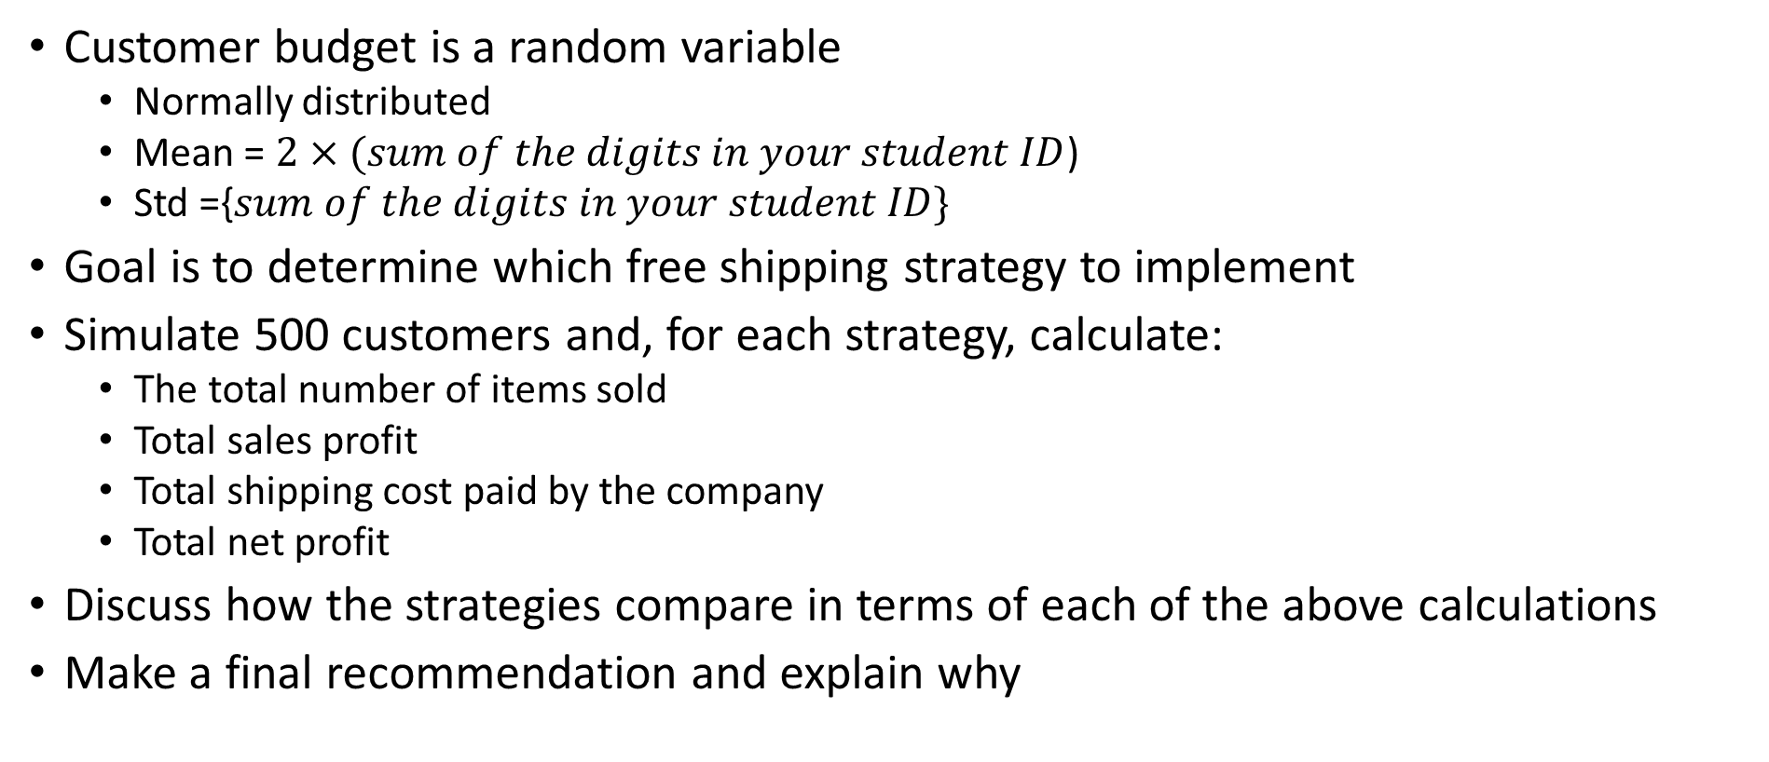
Customer Budget and Monte Carlo
Customer budget is a random variable
  Normally distributed
  Mean = $2×(sum of the digits in your student ID$)
  Std ={$sum of the digits in your student ID\}$
Goal is to determine which free shipping strategy to implement
Simulate 500 customers and, for each strategy, calculate:
  The total number of items sold
  Total sales profit
  Total shipping cost paid by the company
  Total net profit
Discuss how the strategies compare in terms of each of the above calculations
Make a final recommendation and explain why

Slide 56
Submission
Submit one excel file with two sheets
  Sheet 1 is for the Monte Carlo Simulation and calculations:
    One column for customer number and one column for randomly generated budgets
    4 strategies, and 4 columns for each strategy
      4 columns for the strategy calculate NB, CSP, CSC, and NPC, respectively, from each customer
    See example template on the next slides
  Sheet 2 answers the following questions:
    How do different strategies compare in terms of the total number of items sold? Are the results in line with your expectations? Explain the relationships observed.
    How do different strategies compare in terms of total shipping cost incurred by the company? Are the results in line with your expectations? Explain the relationships observed.
    How do different strategies compare in terms of total net profit of the company? Are the results in line with your expectations? Explain the relationships observed.
    Based on your analysis and discussions, which free shipping strategy should be selected? Provide a detailed explanation for your choice.
    How could the simulation process be improved for this problem? Discuss any potential enhancements or adjustments that could be made to obtain more accurate or insightful results. (2-3 sentences will be enough).
  See example template on the next slides

Slide 57
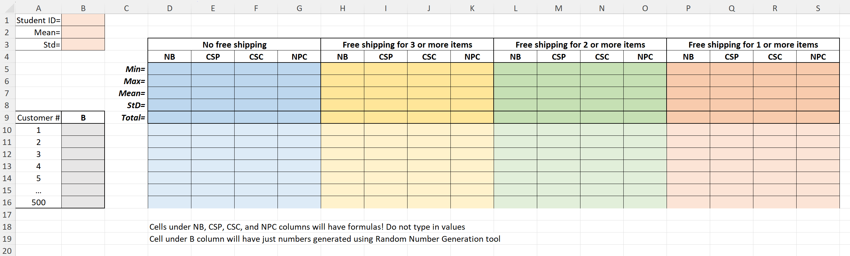
Submission
Sheet 1:
  Random number generation is 1 point
  Correct calculations for each strategy is 2 points
  Columns D-S will have formulae

Slide 58
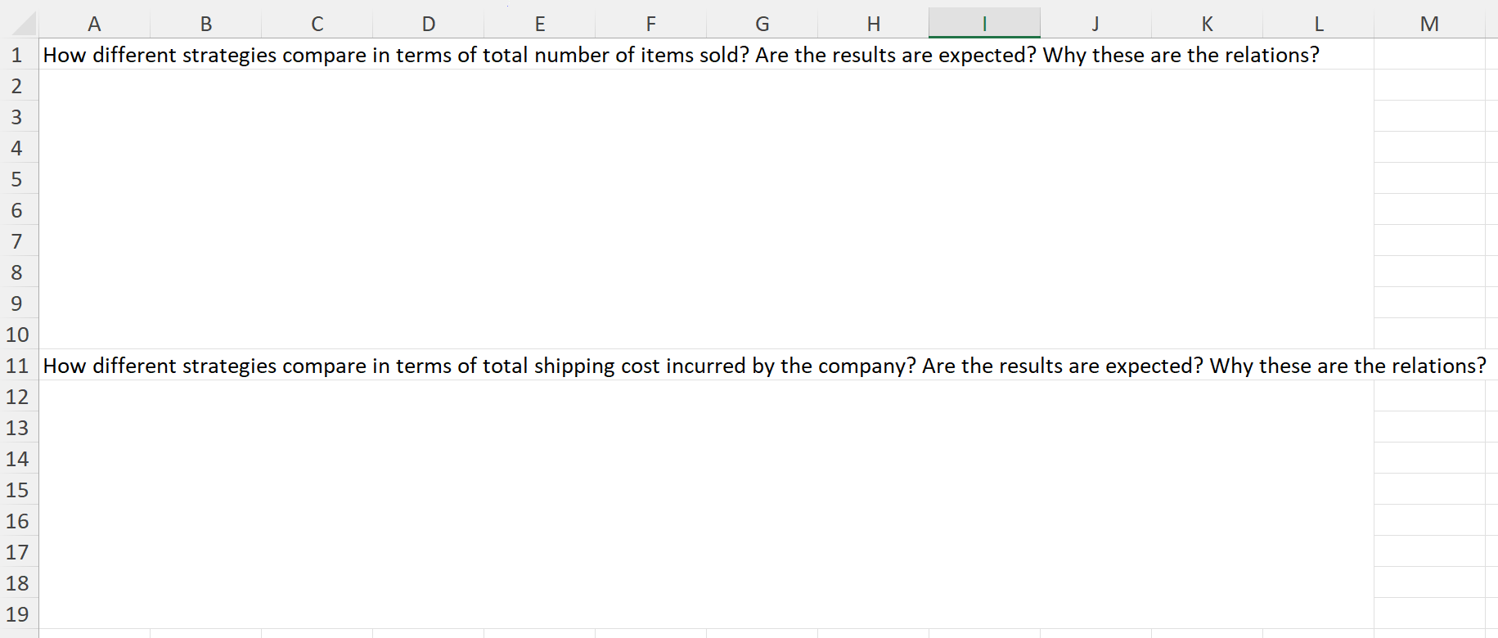
Submission
Sheet 2:
  Questions 1, 2, 3, and 5 are 1 point each
  Question 4 is 2 points

Slide 59
Submission
Additional Instructions
  Name your file as ‘Module 2 – Project – Your Name.xlsx’. Ensure that your name is correctly spelled and that the file extension is .xlsx.
  Ensure that your Excel file is neatly organized and clearly labeled, with appropriate headings for each section and column.
  Double-check your formulas and calculations for accuracy.
  Provide clear and concise explanations in your analysis, supported by data from the simulation.

